Slide 1
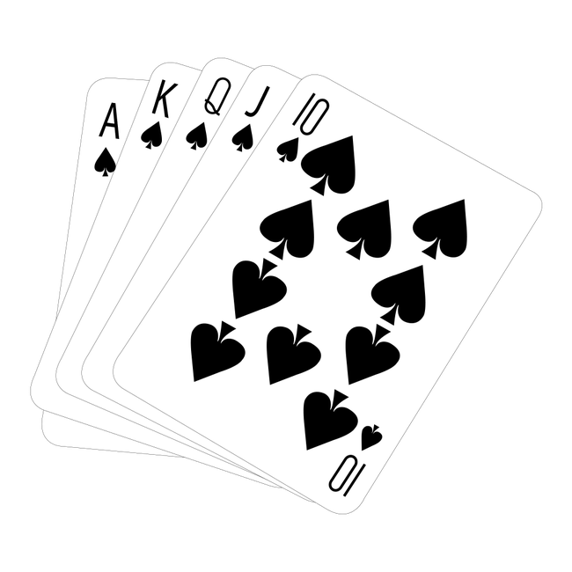
Team 5: UTC Poker Club
James Hare
Richard Kimsey
Javier Martinez
Daniel Velasquez
Loro Dumo

Slide 2
Executive Overview - The problem statement
-The version we are in charge of implementing is Three Hand Poker.
-The project specifications state that the product must include screen with a menu to select from a suite of card games
-It should run on a standalone, portable device and should not depend on access to the Internet for operation
-The interface should be simple and easy to operate and it should use standardized rules for the poker and can be allowed to furnish a fixed “stake” for each game play

Slide 3
Executive Overview - The solution
-Our solution is built in Microsoft’s Visual Studio in C# and uses the .Net framework
-Our solution to address this consumer interest was to deliver a windows console application which operates without the need for an internet connection..
-Our product is not flashy and has a simple user interface that is easy to use.
-Our product opens quickly and is easy to install so users can play quick games of three hand poker on the go.

Slide 4
Executive Overview - The implementation
-Configuration Manager kept track and managed changes that were made to the software
-First Week Sprint: Work on using user stories
-Second Week Sprint:Software Quality Test
-If user stories passed SQA, they will be moved on to peer review by another developer
-Merged into production environment if user stories are found without defect

Slide 5
Executive Overview - The deliverables
The final product is a windows executable file that is easy to setup and play.
The executable includes a game selection menu with a Three Card Poker game currently implemented
Gameplay is designed primarily for mouse interaction, and works well with touch screens
The executable uses a configured blackjack logic with the Simple DirectMedia Layer Library for graphics and input. Additional logic is used for the game menu.

Slide 6
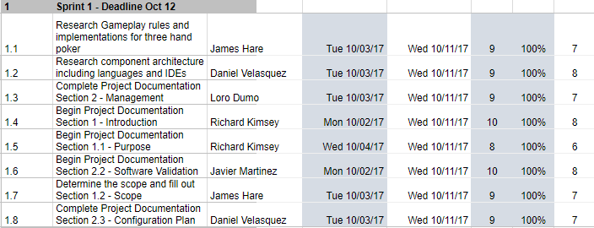
Final Product Schedule and Plan - Sprint 1

Slide 7
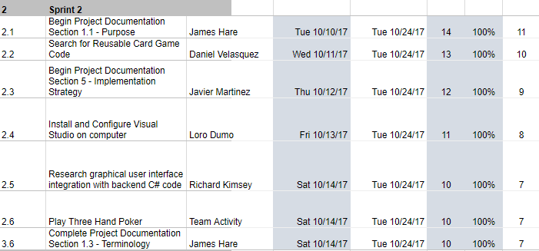
Final Product Schedule and Plan - Sprint 2

Slide 8
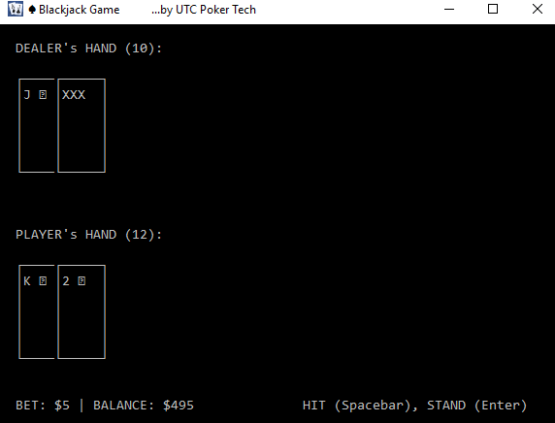
Sprint 2 -Deliverable

Slide 9
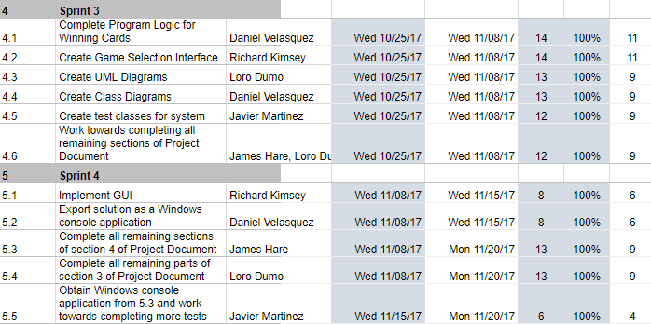
Final Product Schedule and Plan - Sprint 3 - 4

Slide 10

Final Project Modeling
-High level architecture for <Three Hand Poker Library> and User Interface.

Slide 11
Final Project Status
-We fulfilled the requirements for the final project but there is always room for improvement.
-Includes a beginning menu with options to play other poker games which can be implemented in later iterations and when the game quits it returns to this menu.
-Our final project included delivering an easy install version and the source code to the business

Slide 12

Final Project Demo

Slide 13
What’s next
Code refactoring
Add more three card poker features (pair plus wager)
User interface improvements
Ports to mobile, other platforms

Slide 14
Lessons Learned
- Research Costs are hard to estimate: It can be difficult to estimate the amount of time and resources required to effectively search and find reusable code that fits your project’s purpose.
-Software Quality Assurance is a bigger part of the development process than we had originally thought it was. For example: There was a version in the end which we rolled back because it could not be tested sufficiently before the deadline.
-Good communication is essential between developers in order to help each other understand code changes and merge code together. Well documented code only helps so much.
-Requirements specification and documentation is a complex process and important to detail is important because how something is phrased can largely affect the business’s perspective on the developer’s jobs.

